Slide 1
NETWORK & UDP PROTOCOLS

Slide 2
UDP (User datagram protocol)
UDP is a set of rules used to send data between computers over internet. For data transmission, This protocol needs no connection between the computers. This protocol will not guarantee the delivery of data between systems.

Slide 3
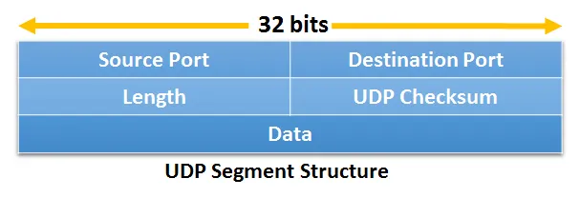

Slide 4
The UDP header consists of four fields each of 2 bytes in length –
Source Port (16 bits) – This field identifies the sender’s port. Cleared to zero if not used.
Destination Port (16 bits) – This field identifies the receiver’s port.
Length (16 bits) – The length in bytes of the UDP header and the encapsulated data. The minimum value for this field is 8.
Checksum (16 bits) – The checksum field may be used for error-checking of the header and data. This field is optional in IPv4, and mandatory in IPv6. The field carries all-zeros if unused. Needed with zero bytes at the end to make a multiple of two bytes. If the checksum is cleared to zero, then the checksum is disabled. If the computed checksum is zero, then this field must be set to 0xFFFF

Slide 5
Network Layer Protocol
Internet protocol (IP)
Internet is defined as an interconnection of autonomous computers located at different points..
To make communication among these computers, we are in need of communication standards (structure, etc). These standards are called protocols.
Therefore internet protocol (IP) is defined as a standard used for communicating data packets (datagrams) from source to destination using Internet. In general internet protocol (IP) takes care of handling the actual delivery of data.

Slide 6
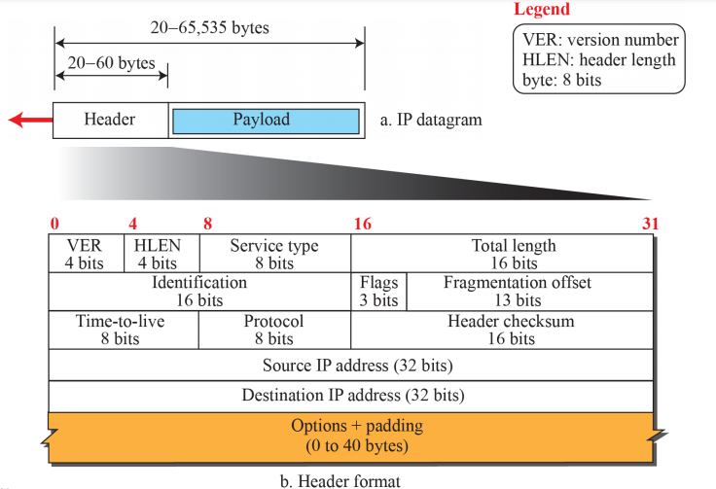

Slide 7
Version
It contains the version of the protocol used. For example IPV₄, IPV₆.
IHL
It contains the length of the datagram header in 32 bit length.
Type of service
This is used to tell the subnet about the service it wants. For example, for file transfer, error free transmission is more important than fast transmission.
Total length
This field contains total length of the datagram including header and data. The maximum length is 65, 535 bytes.
Identification
The identification number helps the destination in reassembling the datagram.
Flag
This is a three bit field. First bit is reserved. The next bit is ‘called do not fragment bit. if it is 1, the router will not fragment the datagram because, the destination is incapable of putting the pieces back together again. If 0, the datagram will be fragmented.

Slide 8
Fragment offset
This value tells the relative position of the fragment (portion) within the datagram.
Time to live
This value is used to control the packet life time. This contains a counter. For each hop (jump) from one router to other the counter value will be decremented.
Protocol
This field defines the higher level protocol that uses the services of IP layer.
Header checksum
This value is used to check the errors generated by bad memory words inside a router.
Destination address
IP address of the destination.
Source address
IP address of the source.
Option
This field is used for network testing and debugging.
Data
This field contains the user data to be send to the destination.

Slide 9
Interior gateway protocols (IGP)
A interior gateway protocol is a protocol for exchanging routing information between hosts (terminal) connected in routers within an autonomous network such as LAN. The exchanged routing information will be then used by the Internet protocol (IP) to route the transmission. The following are the different types of interior gateway protocol.

Slide 10
ICMPv4 (internet Control Message Protocol version 4 )– It helps IPv4 to handle some errors that may occur in delivery.
IGMP(Internet Group Management Protocol) – It is used to help IPv4 in multicasting.
ARP (Address Resolution Protocol)– It is used in address mapping
RARP (Reverse Address Resolution Protocol)-It is protocol used to find the IP address of a host terminal.

Slide 11
ICMP
The Internet Control Message Protocol (ICMP) is a network layer protocol used by network devices to diagnose network communication issues.
ICMP is mainly used to determine whether or not data is reaching its intended destination in a timely manner. Commonly, the ICMP protocol is used on network devices, such as routers.
ICMP is crucial for error reporting and testing, but it can also be used in distributed denial-of-service (DDoS) attacks.

Slide 13
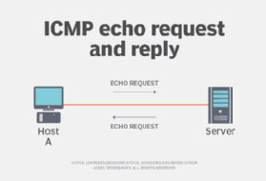

Slide 14
ARP
The full form of ARP is address resolution protocol.
It is a network layer protocol used to convert IP address into physical address such as an Ethernet address.
If a host terminal need the physical address of another host, it gives the ARP request to the TCP/IP network terminals with the IP address.
The host terminal on the network that has the IP address then replies with its physical address to the requesting host terminal.

Slide 15
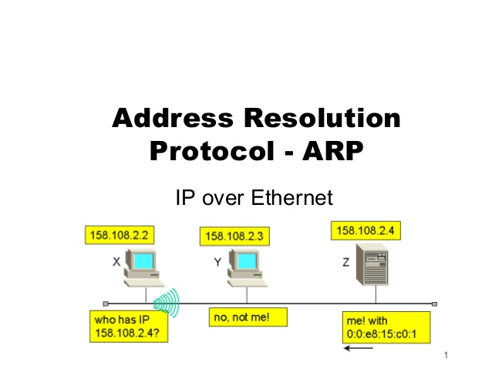

Slide 16
RARP
The full form RARP is reverse address resolution protocol. It is protocol used to find the IP address of a host terminal.
When a host terminal need its IP address it gives a RARP request to the TCP/IP network terminals. The server on the network recognizes the request and returns the IP address.

Slide 17
